Slide 1
CS35L – Fall 2018
Slide set: | 9.2
Slide topics: | Source control, Git
Assignment: | 9

Slide 2
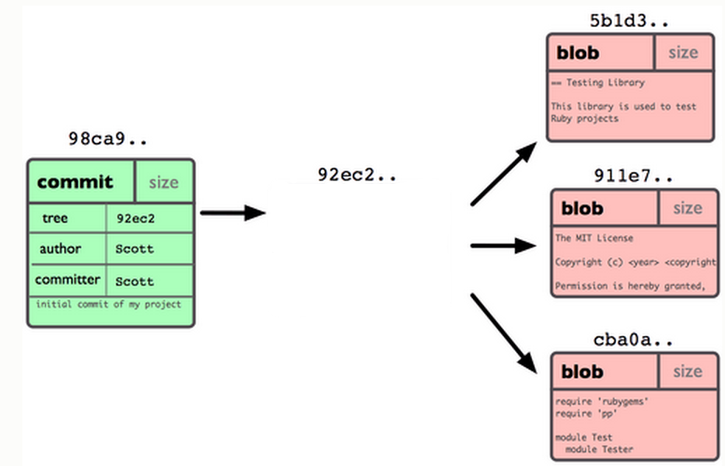
Git Repo Structure
Snapshot
tree |  | size
blob | 5b1d3 | README
blob | 911e7 | pacman.c
blob | cba0a | pacman.h

Slide 3
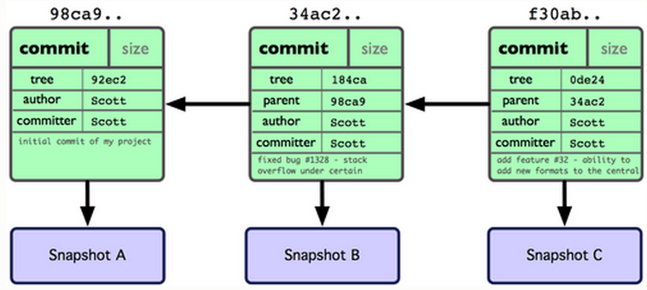
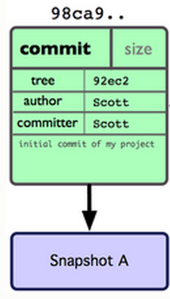
After 2 More Commits…

Slide 4
What Is a Branch?
A pointer to one of the commits in the repo (head) + all ancestor commits
When you first create a repo, are there any branches?
Default branch named ‘master’
The default master branch
points to last commit made
moves forward automatically, every time you commit

Slide 5
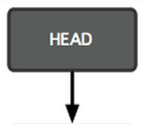
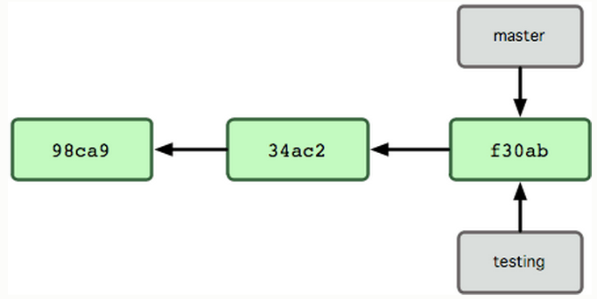
New Branch
Creating a new branch = creating new pointer
$ git branch testing
Where is new branch created?
Current commit
Where is current commit?
HEAD

Slide 6
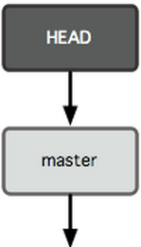
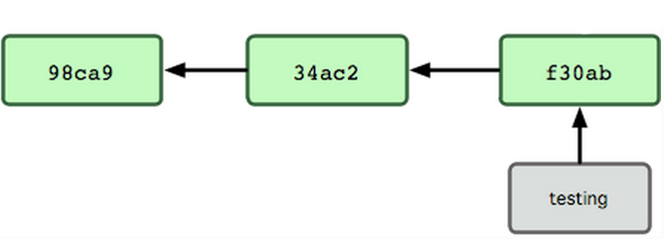
New Commit
What happens if we make another commit?
345f5

Slide 7
Switching to New Branch
Check out new branch
$ git checkout <branch_name>
$ git checkout testing

Slide 8
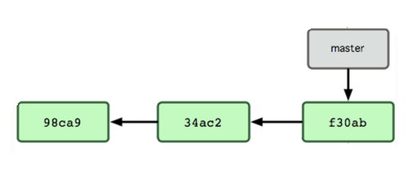

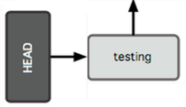
Commit After Switch

Slide 9
Why Branching?
Experiment with code without affecting main branch
Separate projects that once had a common code base
2 versions of the project

Slide 10
Homework 9
Publish patch you made in lab 9
Create a new branch “quote” of version 3.0
Branch command + checkout command (git branch quote v3.0; git checkout quote)
$ git checkout v3.0 -b quote
Use patch from lab 9 to modify this branch
Patch command
$ patch –pnum < quote-3.0-patch.txt
Modify ChangeLog file in diffutils directory
Add entry for your changes similar to entries in ChangeLog
Commit changes to the new branch
$ git add . $ git commit –F <Changelog file>
Generate a patch that other people can use to get your changes
$ git format-patch -[num] --stdout > formatted-patch.txt
Test your partner’s patch
Check out version 3.0 into a temporary branch partner
Apply patch with git am command: $ git am < formatted-patch.txt
Build and test with $ make check
Make sure partner’s name is in HW9.txt for #8

Slide 11
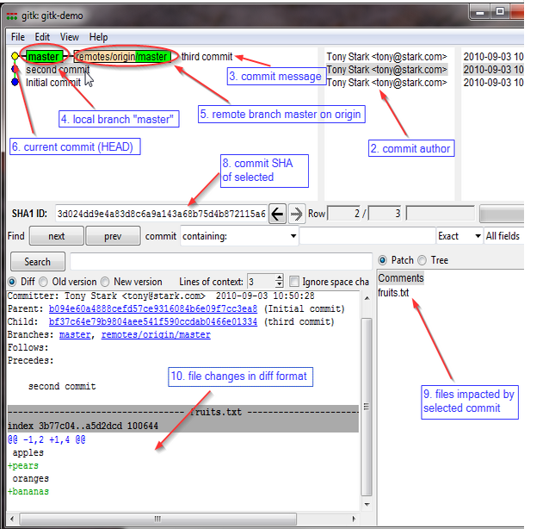
Gitk
A repository browser
Visualizes commit graphs
Used to understand the structure of the repo
Tutorial: http://lostechies.com/joshuaflanagan/2010/09/03/use-gitk-to-understand-git/

Slide 12
Gitk
SSH into the server with X11 enabled
ssh -X for OS with terminal (OS X, Linux)
Select “X11” option if using putty (Windows)
Run gitk in the ~eggert/src/gnu/emacs directory
Need to first update your PATH
$ export PATH=/usr/local/cs/bin:$PATH
Run X locally before running gitk
Xming on Windows, Xquartz on Mac

